Slide 1
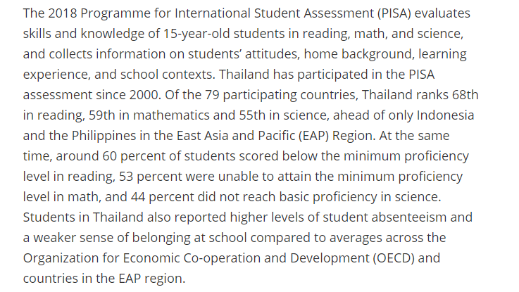
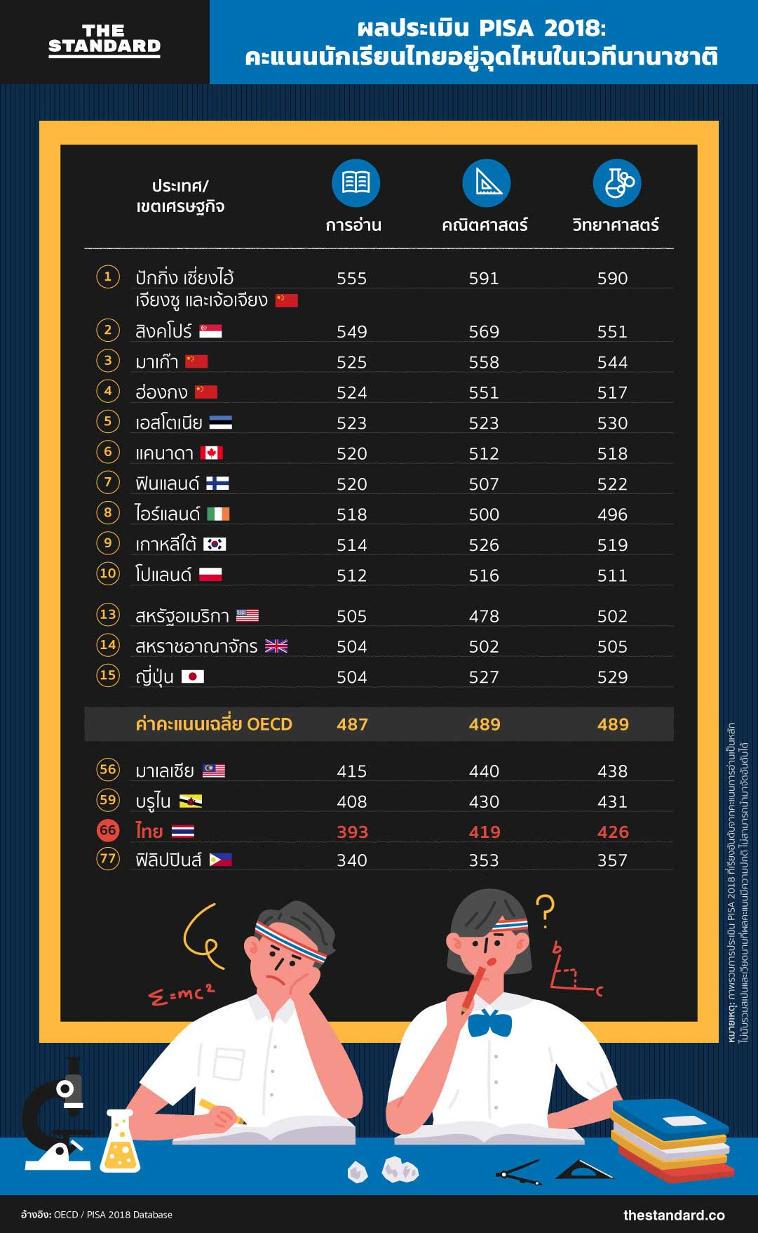
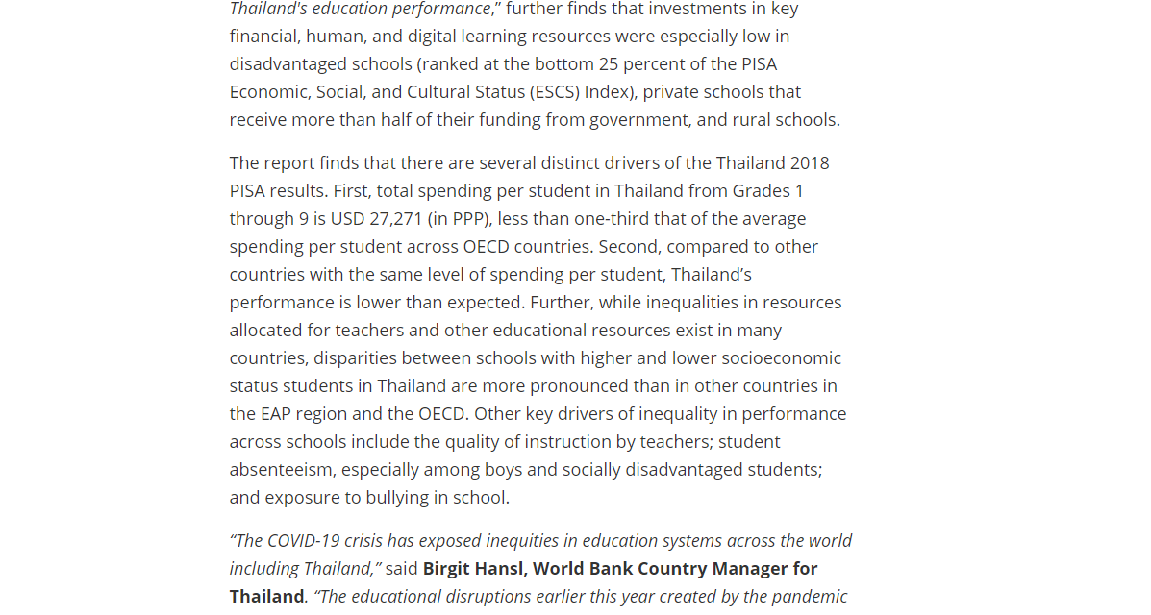
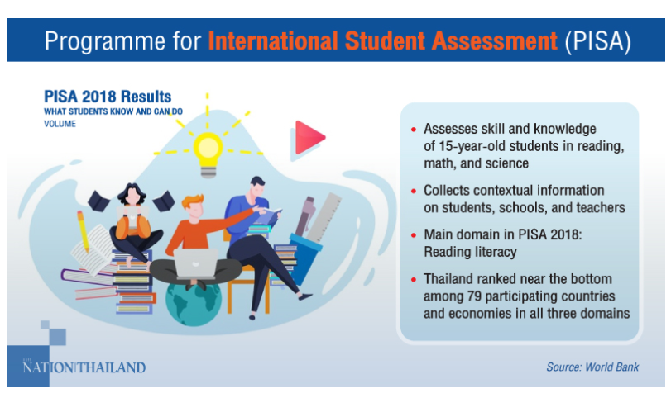
Current status of education in Thailand towards global ranking is still under OECD average score in reading, mathematics, and science.
https://www.nationthailand.com/edandtech/30399366
https://thestandard.co/pisa-2018-2/
คำสั่ง : ให้ศึกษาข้อมูลที่ได้เตรียมไว้ให้ข้างต้น โดยวิเคราะห์ข้อมูลและศึกษา จากนั้นดีไซด์ เนื้อหาให้เหมาะสมกับ Key Massage ที่ให้ไว้ข้างต้น การวิเคราะห์ข้อมูลที่ดีจำเป็นต้นอ่านเนื้อหาให้เข้าใจและสรุปออกมาได้ใน 1 หน้าค่ะ
Source: Pisa Score Report 2018
Notes:
https://www.worldbank.org/en/news/press-release/2020/12/09/world-bank-more-inclusive-and-better-investments-in-education-to-improve-learning-outcomes-in-Thailand
https://www.worldbank.org/en/news/press-release/2020/12/09/world-bank-more-inclusive-and-better-investments-in-education-to-improve-learning-outcomes-in-Thailand
There are several drivers of Thailand 2018 pisa results
1.
2.
3.
Thai government gives less funding and technology supports to rural schools
The International PISA scores revealed that there were greater improvements in scores among students from schools in big cities than those from small schools in small cities.
Individual teachers in rural school often teach multiple grades and subjects
The Thai’s education system has been using the same curriculum since 2008
OECD (pisa 2018) https://gpseducation.oecd.org/CountryProfile?primaryCountry=THA&treshold=10&topic=PI
Tertiary education refers to any type of education pursued beyond the high school level.
https://www.usnews.com/news/best-countries/best-education
https://ceoworld.biz/2020/05/10/ranked-worlds-best-countries-for-education-system-2020/
https://theaseanpost.com/article/inequality-education
The Organisation for Economic Co-operation and Development (OECD) is an international organisation that works to build better policies for better lives.
The 2012 international PISA scores revealed that there were greater improvements in scores among students from schools in big cities than those from small schools in small cities.
Going by the Programme for International Student Assessment (PISA) scores for the last three surveys (2009, 2012 and 2015), Thailand’s education system has been struggling. In 2009, its overall ranking was 50th out of 65 countries, in 2012, Thailand was ranked 50th again out of 65 countries, and in 2015, it ranked 54th out of 70 countries.
The World Economic Forum’s (WEF) Global Competitiveness Index 2017-2018, did not have anything different to say about the country’s education system either. For Higher Education and Training, Thailand was placed 57th out of 137 countries. Brunei was 67th, Cambodia was 124th, Indonesia was 64th, Lao PDR was 105th, Malaysia was 45th, Myanmar was 108th, Philippines was 55th, Singapore was first and Vietnam was 84th.

Slide 2




Current status of education in Thailand towards global ranking is still under OECD average score in reading, mathematics, and science.
assesses skill and knowledge of 15-year-old students in reading, mathematics, and science.
THAILAND’S RANKING IN 2018
READING
68th
MATH
59th
Thailand ranked near the bottom among 79 participating countries and economies in all three domains.
Collects information on:
SCIENCE
students' attitudes
home background
learning experience
school contexts
THAILAND has participated in the PISA assessment since 2000.
55th
Notes
Around 60% of Students score below minimum proficiency level in Reading
53% were unable to attain the minimum proficiency level in Math
44% did not reach basic proficiency in Science
Thailand also reported higher levels of student absenteeism and weaker sense of belonging school compared to averages across the OECD and countries in the EAP region

